Slide 1
Module 35: Invoking Enterprise Integration Manager
Siebel Core Developer and Technology School
Notes:
Time: Lecture: 35 – 40 minutes; labs: 70 – 95 minutes
Intent: To explain how to invoke an EIM task and verify the results.
Flow: Interface table structure; temporary columns; process for loading and verifying EIM tables; configuration file and associated options; EIM processing; disabling transaction logging for initial loads; invoking an EIM task; verifying EIM tasks; and clearing out EIM tables.
Key Terms:
Interface table (EIM table)
T_ column
.ifb file (configuration file)
Server Manager
IF_ROW_STAT column
Please note: Faculty-specific notes are italicized.

Slide 2

Module Objectives
After completing this module you will be able to:
  Populate interface (EIM) tables for inserts and deletes
  Modify configuration (.ifb) files for inserts and deletes
  Invoke an Enterprise Integration Manager (EIM) server task
Why you need to know:
  To successfully import external data into the Siebel database and perform batch deletes

Slide 3
Interface Table Structure
All interface tables have three columns that must be populated in addition to the data that was mapped
  IF_ROW_BATCH_NUM, ROW_ID, IF_ROW_STAT
Number to identify all records that should be processed in the batch
Unique number to identify the record in the batch
Non-null character value which is reset during the run
IF_ROW_BATCH_NUM | Row_ID | IF_ROW_STAT | NAME
100 | 1 | FOR_IMPORT | Photocopier
100 | 2 | FOR_IMPORT | Fax Machine
200 | 1 | FOR_IMPORT | Shredder
200 | 2 | FOR_IMPORT | Toner Cartridge
FOR_IMPORT specifies that the row is for import; FOR_DELETE specifies delete
Notes:
The example shows two different batches in the same table. Notice that ROW_ID does not need to be unique across batches. ROW_ID is unique only within a batch. Do not confuse this ROW_ID with a real Siebel ROW_ID on a base table. Also, it is necessary to provide some non-null character in the IF_ROW_STAT column.

Slide 4
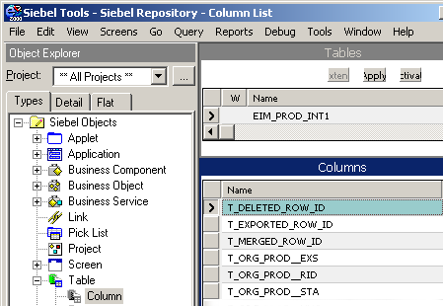
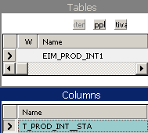
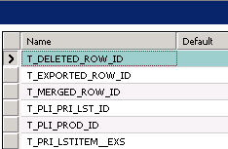
EIM T_ Columns
All interface tables have T_ columns to hold temporary values and status used during processing step
Temporary values
Status of target table
Notes:
T_ columns that end with __STA are status columns and can provide additional troubleshooting assistance. Refer to the Siebel Enterprise Integration Manager Administration Guide.

Slide 5
Load EIM Tables
Load source data into EIM tables using non-Siebel process
  Use database vendor utilities such as DTS, bcp or SQL Loader to load data from flat files
  Use SELECT INTO to pull data from other SQL databases
  Write programs or stored procedures to cleanse or preprocess and insert rows
  Use direct SQL insert, update, or delete statements to update columns in EIM tables
External Data
EIM_PROD_INT
Non-Siebel process
Notes:
The point here is that one is free to use whatever process works to load the data into the EIM table. Direct SQL insert, updates, and deletes are fully supported against EIM tables. Remember these tables do not have a Siebel-maintained ROW_ID column. In the lab, there will be an opportunity to use a DTS tool provided by the RDBMS vendor to load the data.

Slide 6
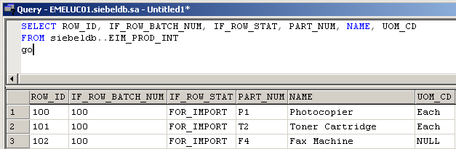
Verify EIM Load
Use SQL to verify the EIM tables loaded correctly
Update values using SQL if necessary
Notes:
The point here is do not blindly load data and run EIM. Instead, be sure to verify that the EIM table contents are correct before proceeding.

Slide 7
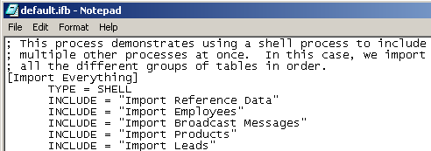
Processing Order
Determine the correct processing order for EIM tables
  When importing, tables referenced via foreign key must be
  loaded first
  Refer to the default.ifb and Siebel Bookshelf for recommended processing order
Order
Notes:
Processing order is very important to EIM. Remember that the EIM process will look up data in one base table that is referenced by another base table to resolve and set the foreign key values. This means that if a base table has a foreign key pointing to another table, that other table must be loaded first. For example, if A points to B, then B must be loaded first.

Slide 8
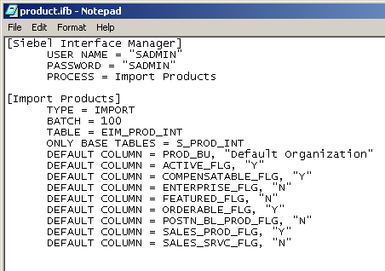
Configuration (.ifb) file: Imports
Direct execution of an EIM task using a configuration (.ifb) file
  Specifies the batch, order, and type of processing
  Uses the default.ifb as a template
Section to process
IF_ROW_BATCH_NUM value - rows to process
Destination table
EIM table
Default column values
Notes:
This slide annotates the .ifb file. Point out the easy way to set default values for required columns if you are not using them in your implementation.
Troubleshooting: Some EIM tables do not support the DEFAULT COLUMN parameter. You can also load defaults directly into the EIM table, for example with the SET SQL statement.

Slide 9
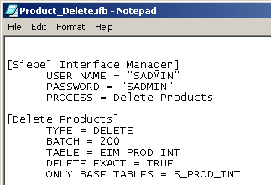
Configuration (.ifb) file: Deletes
Set configuration (.ifb) file parameters to specify type of delete
  DELETE EXACT
  DELETE MATCHES
  DELETE ALL ROWS
Section to process
EIM table
Notes:
This slide annotates a delete configuration file. This is a positioning slide. Each of the three parameter choices will be explained in subsequent slides.
The DELETE ROWS parameter is set to TRUE by default for all tables mapped to the interface table. By setting it to FALSE, you prevent rows from being deleted from a table.

Slide 10
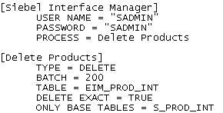
Delete Exact
Deletes rows in base table with user key values specified in the interface table
  Base table identified with ONLY BASE TABLES parameter is affected
  Delete is cascaded, updating or deleting rows in other base tables that have foreign keys to the affected table
  EIM tables used for the delete need only contain the user key values not the entire record
Ensures that any columns that are not part of the user key are NULL in the interface table
Example:

Slide 11
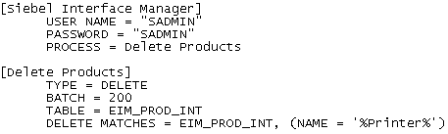
Delete Matches
Deletes rows based on a WHERE clause
Defines interface table and filter expression to be used against target base table
Example:

Slide 12
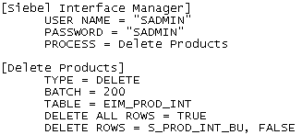
Delete All Rows
Deletes all rows in named table
  Valid values are TRUE and FALSE
Example:
Notes:
The DELETE ALL ROWS parameter is a way in which you can prevent rows from being deleted from a specified table. It is set to TRUE by default.

Slide 13
Delete Rows
Prevents deletion from specified tables
  Set to TRUE by default
  Set DELETE ROWS to FALSE and specify the tables to prevent deletions
Example:

Slide 14
Cascade Delete Only
Determines how child records are handled when the parent record is deleted
  Set to FALSE by default; sets the foreign keys of child records to NULL
  Set to TRUE to delete child records with nullable foreign keys
Requires one of the delete parameters
  Delete Exact
  Delete Matches
  Delete All Rows
Notes:
CASCADE DELETE ONLY determines how child records are handled when the parent record is deleted.
Set this parameter to TRUE to delete child records with nullable foreign keys when the parent record is deleted. If FALSE, when EIM deletes a parent record, it sets the foreign keys of the child records to NULL.
You must use one of the DELETE parameters: DELETE EXACT, DELETE MATCHES, or DELETE ALL ROWS.

Slide 15
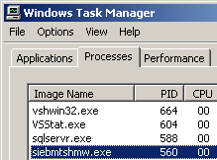
Running an EIM Task
Creates an operating system (OS) process that writes log entries, reads the .ifb file, loads the dictionary, and executes EIM steps
Example:
Dictionary
EIM
Siebel
Server
OS process
.ifb
log
Notes:
The dictionary files are created automatically by server tasks. Once they are created they are used to speed processing time. If the files are removed they will be re-generated automatically.
The example shows a Windows process.

Slide 16
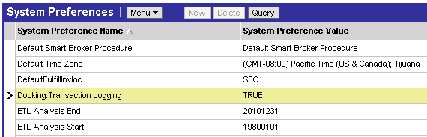
EIM and Transaction Logging
Transactions are logged during EIM to synchronize mobile clients
  Before initial loads, turn off logging
    Navigate to Administration - Application > System Preferences
  After initial loads, turn on logging to support mobile clients
Notes:
Turning off logging during initial loads will greatly improve performance for large amounts of data.

Slide 17
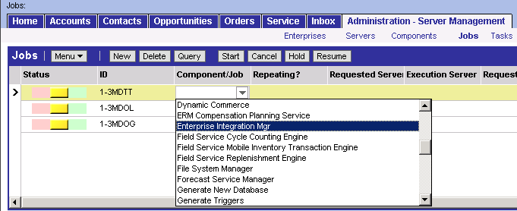
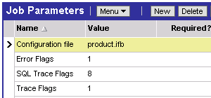
Invoking EIM
Navigate to Administration - Server Management > Jobs
3. Click Start
1. Create new request and select Enterprise Integration Manager
2. Specify parameters
Notes:
This slide illustrates steps to create an EIM task.

Slide 18
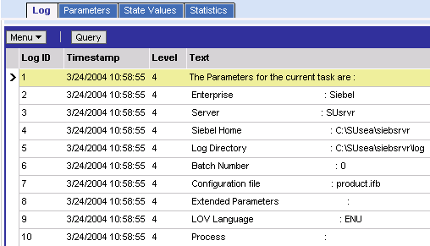
Monitor EIM Task
Navigate to Administration - Server Management > Tasks
  Query to view progress
  Review Task Information Log
Notes:
This slide illustrates how to monitor an EIM task using Server Manager.

Slide 19
Verify EIM Task
Verify EIM task using:
  SQL against the EIM and base tables
  Client application to view data
  Log files to troubleshoot
Notes:
This is a positioning slide. Items are discussed in detail on subsequent slides.

Slide 20
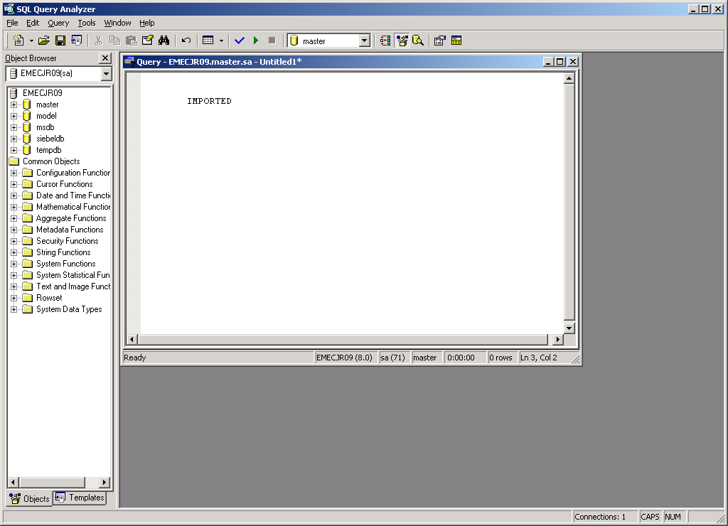

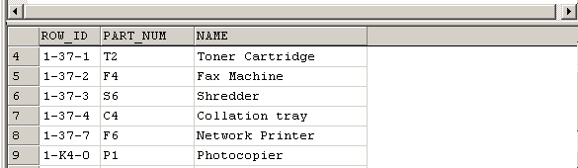
Verify Tables
Run SQL SELECT statements to verify the table data
Notes:
Verify the values in the EIM table were properly set in the target base tables. This example is using MS SQL Server syntax in Query Analyzer. One must use a database tool. Siebel Systems does not provide an interactive SQL utility for server databases, although dbisql.exe is provided for SQL Anywhere local databases.

Slide 21
Common IF_ROW_STAT Values for Imports
IMPORTED
  Success for all target/destination tables
PICKLIST_VALUES
  Failed because required picklist value not found in S_LST_OF_VAL
REQUIRED_COLS
  Failed because required column has NULL value
DUP_RECORD_EXISTS
  Failed because target table has row with same values
FOREIGN_KEY
  Failed because a required foreign key could not be resolved
PARTIALLY_IMPORTED
  Success for target base table; failure for secondary table
Notes:
This slide highlights common statuses. Refer to the Siebel Enterprise Integration Manager Administration Guide.

Slide 22
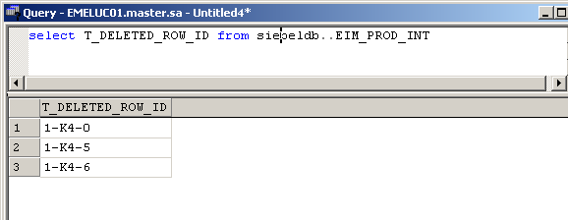
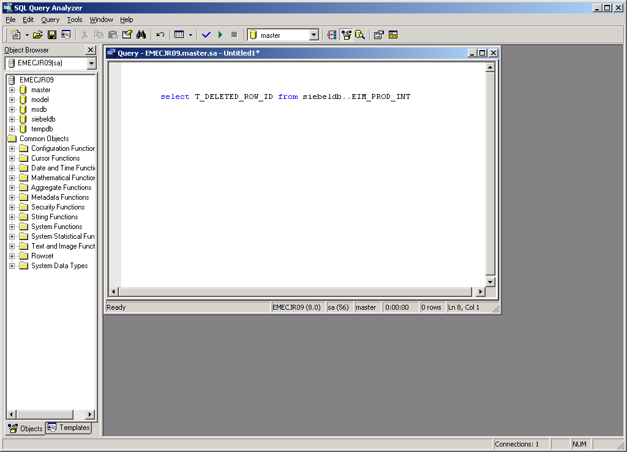
Verify Deletes Using Interface Table
EIM uses the T_DELETED_ROW_ID column on the interface table to record the ROW_ID of deleted rows
Notes:
In the example, Query Analyzer is used to query T_DELETED_ROW on the EIM_PROD_INT table.

Slide 23
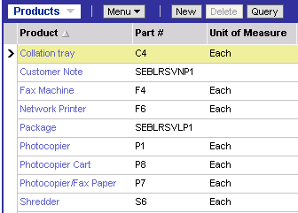
Verify Information in Application
Verify product information is in the application using appropriate views
  Example: Administration - Product
Verify products were imported successfully
Notes:
Make sure the data is visible in the appropriate views in the application. Data may not be visible in other views if teams or owners were not imported.

Slide 24
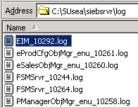
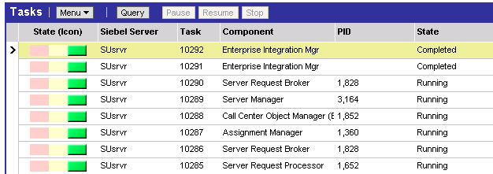
Verify Log Files
Use log files to troubleshoot
Error information
Corresponds to task number
Notes:
One can also view the logs in the application.
Failures and errors on secondary tables of little importance may be encountered. EIM will do as much work as it can and provide notification of any errors. When errors are encountered, they may not indicate a failure and should be investigated.

Slide 25
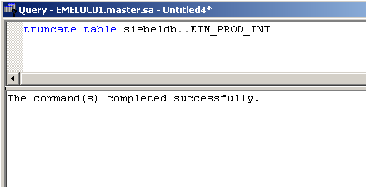
Remove Data from EIM Tables
You are responsible for removing records from the EIM tables
  Use SQL to delete EIM table records once they have been successfully processed
Notes:
Clearing out data from the EIM tables is a good programming practice.

Slide 26
Summary
This module showed you how to:
  Populate interface (EIM) tables for inserts and deletes
  Modify configuration (.ifb) files for inserts and deletes
  Invoke an Enterprise Integration Manager (EIM) server task
Notes:
Review Question: What does the DELETE EXACT parameter do?
True or false: SQL can be used to insert data into an EIM table without compromising referential integrity.
Review Question: What is the purpose of turning off transaction logging during initial loads?

Slide 27
Lab
In the labs you will:
  Use the Enterprise Manager’s Data Transformation Services facility to load external solution data from a file into the appropriate EIM interface table
  Run an EIM task to load the S_RESITEM base table from the EIM_SOLUTION interface table
Notes:
See lab instructions for details.

